Slide 1
Black-Scholes formula
Decision making
Being in-money

Slide 2
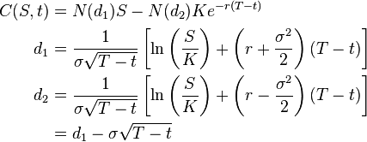

Slide 3
