Slide 1
Math for finance and economics
Interest rates
Marginal cost and revenue
Demand and supply
Elasticity
Production functions
Approximations
Black-Sholes equation

Slide 2
Interest rates
$F=P(1+it)$ simple interest
$F=P{(1+i)}^{t}$ discrete compound interest
$F=Pe^{it}$ continuous compound interest

Slide 3

Marginal cost and revenue
$$\frac{dC}{dA}$$
$$\frac{dR}{dA}$$

Slide 4
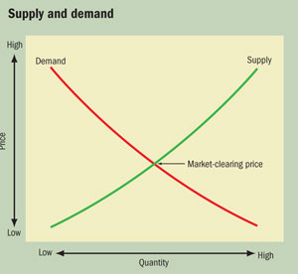
Demand and supply

Slide 5

Elasticity
$$\frac{P}{D}\frac{dD}{dP}$$
$$\frac{P}{S}\frac{dS}{dP}$$

Slide 6
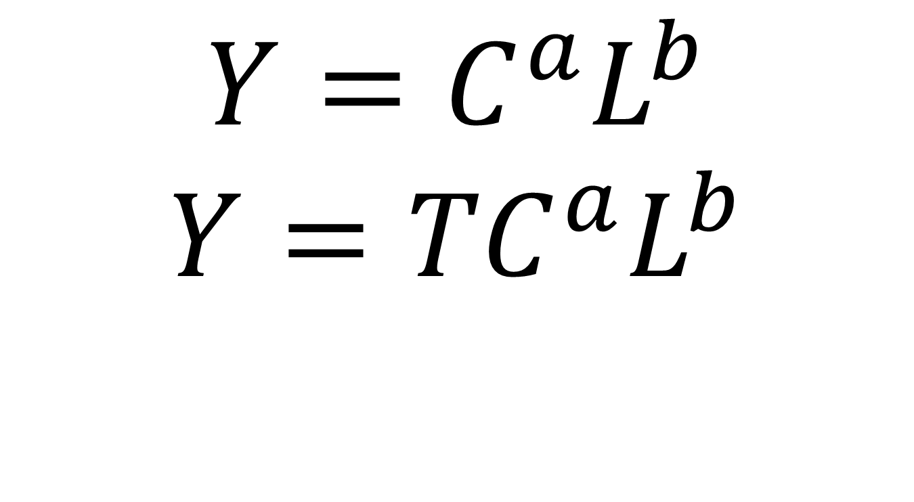
Production functions
$$Y=C^{a}L^{b}$$
$$Y={TC}^{a}L^{b}$$

Slide 7
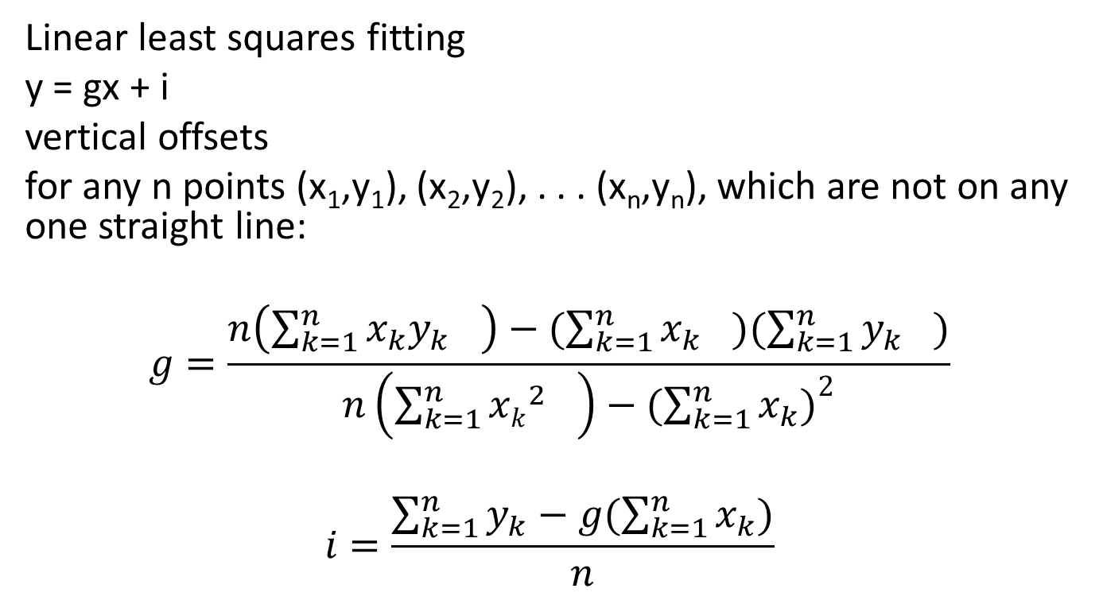
Approximations
Linear least squares fitting
y = gx + i
vertical offsets
for any n points (x₁,y₁), (x₂,y₂), . . . (x_{n},y_{n}), which are not on any one straight line:
$$g=\frac{n\left({\sum_{k=1}^{n}{x_{k}y_{k}}}_{}\right)−({\sum_{k=1}^{n}{x_{k}}}_{})({\sum_{k=1}^{n}{y_{k}}}_{})}{n\left({\sum_{k=1}^{n}{{xk}_{}^{2}}}_{}^{}\right)−{(\sum_{k=1}^{n}{x_{k}})}^{2}}$$
$$i=\frac{\sum_{k=1}^{n}{y_{k}}−g(\sum_{k=1}^{n}{x_{k}})}{n}$$

Slide 8
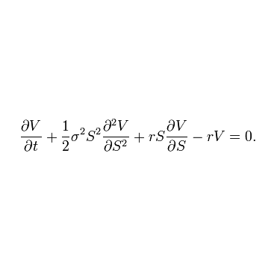
Black-Sholes equation

